Slide 1



CHARUTAR VIDYA MANDAL UNIVERSITY
MADHUBEN AND BHANUBHAI PATEL
INSTITUTE OF TECHNOLOGY
CAREERIQ
Submitted By:
Mohamad Nadeem Memon (Enrollment: 12402040703013)
Rudra Trivedi (Enrollment: 12302040701148)
Subject -Mini Project (202040601)
Class - 6CE3

Slide 2
THE PROBLEM
OUR SOLUTION
Job seekers struggle to identify in-demand skills.
Interactive Web Application using Python, Pandas, and Streamlit.
Difficulty understanding trending roles and location-based opportunities.
Analyzes 13,623 real job listings from Kaggle datasets.
No centralized platform for job market insights in Data Science, AI, ML, and Cloud domains.
Provides data-driven insights through visualizations and filters.

Slide 3
PROJECT OBJECTIVES
PROJECT SCOPE
Analyze real-world job market datasets.
Focus Domains:
Unify multiple data sources into structured format.
Data Science
Extract meaningful insights using EDA.
AI (Artificial Intelligence)
Build interactive dashboard with search and filters.
ML (Machine Learning)
Help users make informed career decisions.
Cloud roles
Filter Options:
Job Title
Role Category
Location
Experience Level

Slide 4






DATA FLOW PIPELINE
RAW DATA (KAGGLE)
DATA PREPROCESSING & CLEANING
DATA INTEGRATION (JOBS_MASTER.CSV - 13,623 RECORDS)
EXPLORATORY DATA ANALYSIS
INTERACTIVE STREAMLIT DASHBOARD
USER INSIGHTS & VISUALIZATIONS
End-to-End Solution: From raw data to actionable intelligence

Slide 5

TECHNOLOGY STACK
PROGRAMMING & LIBRARIES
WEB FRAMEWORK
TOOLS & DATA
Streamlit (Interactive dashboard development)
IDE: VS Code
Python 3.8+ (Core programming language)
Data Source: Kaggle (Naukri listings + Global DS datasets)
Pandas & NumPy (Data manipulation and analysis)
Version Control: Git
Matplotlib & Seaborn (Data visualization)
Minimal Requirements: 4GB RAM, any OS, modern web browser

Slide 6
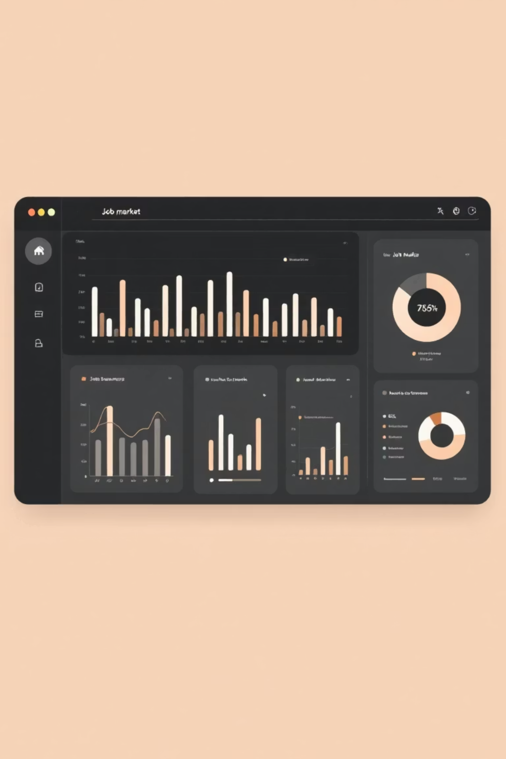
KEY FEATURES
SEARCH & FILTER CAPABILITIES
INTERACTIVE VISUALIZATIONS
Job title search bar
Bar charts for role distribution
Role category dropdown filter
Pie charts for location analysis
Location-based filtering
Statistical summaries and trends
Experience level filtering
Clean, intuitive user interface
Real-time Results: Dynamic filtering of 13,623 job listings

Slide 7





CORE SYSTEM MODULES
DATA COLLECTION
DATA PREPROCESSING
Kaggle dataset acquisition
Cleaning, deduplication, standardization
DATA INTEGRATION
EDA MODULE
Unified master dataset creation
Statistical analysis and pattern identification
STREAMLIT DASHBOARD
VISUALIZATION MODULE
User interface and interactions
Charts, graphs, and visual analytics
Design Approach: Modular architecture for scalability and easy maintenance

Slide 8
5-MONTH DEVELOPMENT PLAN
Month 1
Project planning, literature review, data collection
Month 2
Data preprocessing, cleaning, integration
Month 3
Exploratory Data Analysis, insight extraction
Month 4
Dashboard development, feature integration
Month 5
Testing, optimization, documentation, deployment

Slide 9
EXPECTED OUTCOMES
FUTURE ENHANCEMENTS
Fully functional job market analysis dashboard
Salary prediction using ML models
Clear insights into skill demand and job trends
Personalized skill recommendation system
Practical tool for students and job seekers
Time-based trend forecasting
Hands-on experience with real-world data analysis
Cloud deployment (Streamlit Cloud)
User authentication and saved preferences

Slide 10
CONCLUSION & Q&A
PROJECT IMPACT:
Transforms raw job data into actionable insights
Bridges gap between data analysis and career decisions
User-friendly platform for students and professionals
Scalable foundation for AI/ML enhancements
Key Achievement: 13,623 job listings analyzed across Data Science, AI, ML, and Cloud domains
THANK YOU!
QUESTIONS & DISCUSSION

